Slide 1

Node.js 2
Errors
Client - Server
Http
Node server
Get/Post forms

Slide 2

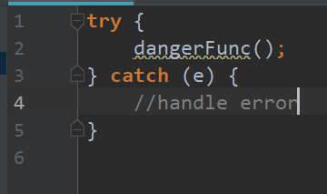

Errors
throw new Error(‘AAAA!!!’)
!=
new Error(‘AAAA!!!’);

Slide 3
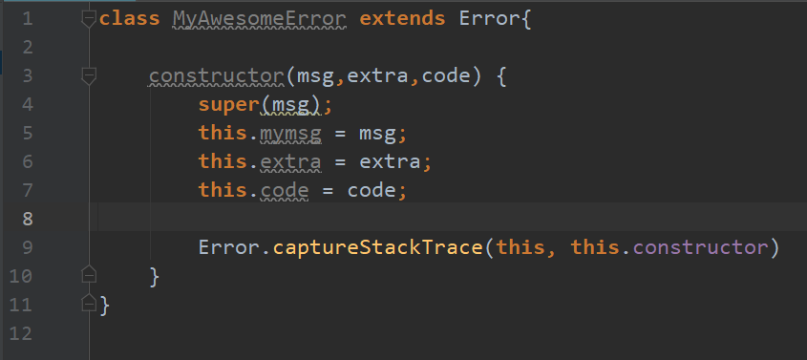
Custom error

Slide 4
HTTP
Client - Server
A
YOUR MACHINE
B
3000
Listen
C
8080
Node server
D
2701
E
F

Slide 5
HTTP Protocol
Request
Response
GET /hello.html HTTP/1.1
User-Agent: Mozilla/4.0
Host: www.oktenweb.com
Accept-Language: en-us
Accept-Encoding: gzip
Connection: Keep-Alive
HTTP/1.1 200 OK
Date: Mon, 27 Jul 2009 12:28:53 GMT
Server: Apache/2.2.14
Content-Length: 88
Content-Type: text/html
Connection: Closed

Slide 6
Status codes
1XX
2XX
3XX
Informational
Success
Redirectional
4XX
5XX
Client Error
Server Error

Slide 7
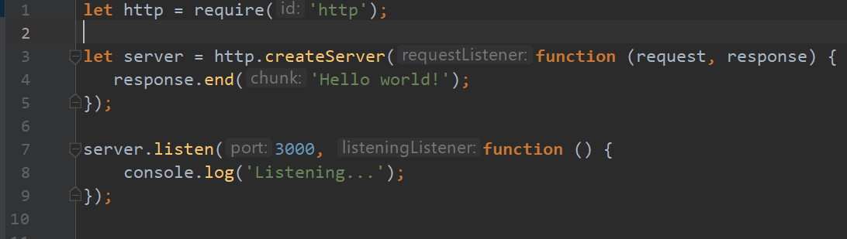
Node.js simple server

Slide 8
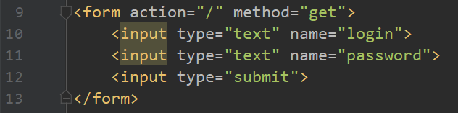
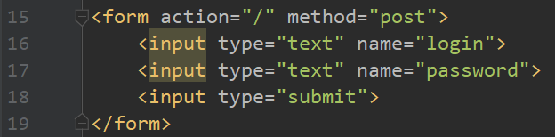
Forms
url.parse(request.url,true)
request.url.query
request.on(‘data’);

Slide 9
Let`s make magic!

